Slide 1
Amateur Radio on a Budget
How to not go completely broke in this hobby.

Slide 2
What Amateur Radio means to you
What you want to do with the hobby?
Where are you going to operate from?
You don’t have to do everything at once.

Slide 3
Where to get equipment
Hamfests
eBay
Private sellers
Retail and Online Stores (Ham Radio Outlet, Amateur Electronic Supply, DX Engineering, Gigaparts, etc.)

Slide 4
Different operations = Different costs
HTs are cheaper than base stations BUT have different attributes.
Antennas (one size does not fit all.)
Associated costs with your equipment (coax, cables, etc.)

Slide 5
FM Operations
Where many hams start (2 meter band)
HTs can be cheap or expensive
Mobile radios are more expensive but can be better in many situations
Don’t forget associated costs (extra batteries, antennas, charging equipment, programming cables, etc.)

Slide 6
HF operations
Mostly base stations but can be mobile or portable
Equipment tends to be higher cost
Home power supply almost always a must have

Slide 7
Data operations
PSK31, SSTV, RTTY, APRS, packet etc.
TNC or Soundcard interface
Some radios have a basic TNC built in
Computer will be needed BUT can also do extra duty (rig control, logging, etc.)
Signalink USB ~$120 with cable for specific radio

Slide 8
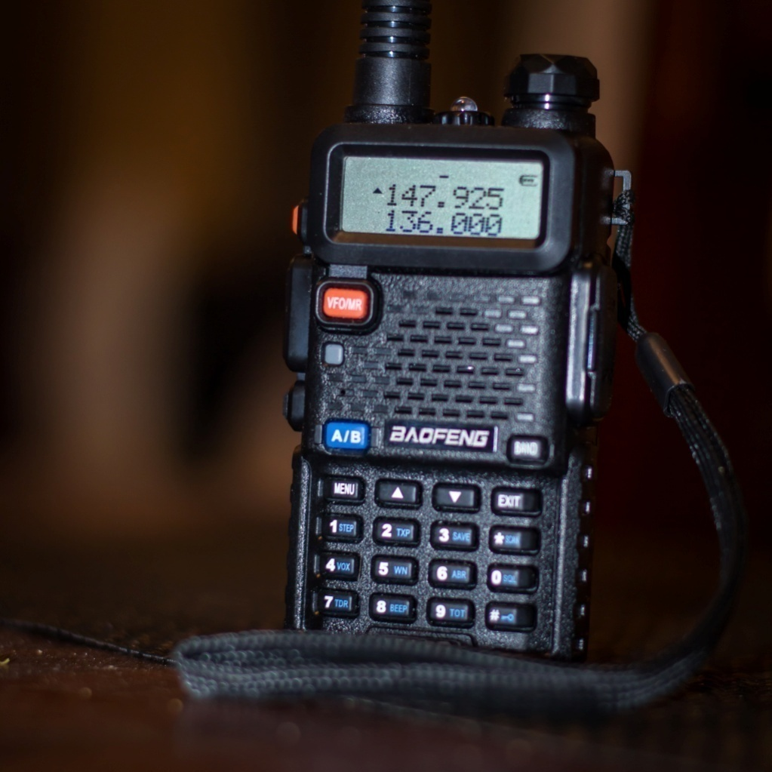
HTs (Handheld operations)

Slide 9
Costs of HT operation
New HTs can be cheap
BaoFeng UV-5R dual bander $26 on Amazon BUT wide open receiver = lots of interference
New brand name HTs (Kenwood, Yaesu, Icom) are more expensive BUT tend to perform better
Also, brand name HTs tend to be easier to program and operate

Slide 10
HT Accessories
Stock antenna = “rubber resistor”
Aftermarket antennas ~$20 and up
DC power cable ~$20
Desk charger ~$30 (standard) or ~$70 (rapid)
Extra batteries
12v power supply (for home use)
Programming cable
Programming software (sometimes free)

Slide 11
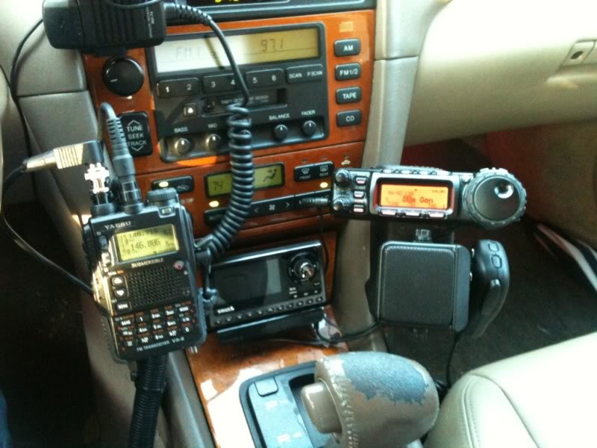
Mobile Operations

Slide 12
Costs of mobile operations
More expensive than HTs
Higher powers and longer ranges (than HTs)
Requires ~12v power supply (vehicle battery or home power supply (for base use))
Vehicle antenna considerations (lip mount, drill holes, magnet mount)
Can be used as base stations

Slide 13
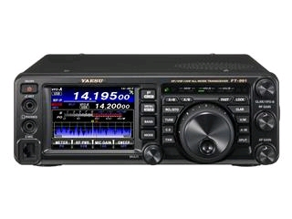
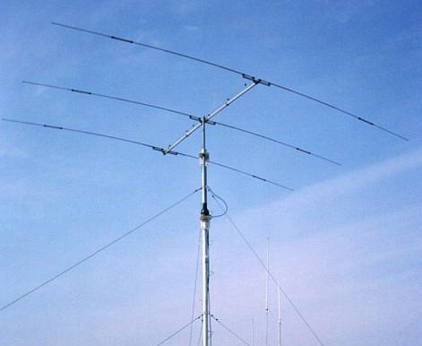
HF Operations

Slide 14
Costs of HF operations
New HF rigs can be expensive
Antennas can be expensive depending on where you have available to mount them
Towers, house mounts, rotators, trees

Slide 15
How to save money (new)
New Chinese made radios
Cheaper alternative but tend to be throwaway items
Harder to program without a programming cable
Compare prices on internet (even Amazon)

Slide 16
How to save money (eBay)
Search generally (2 meter HT, 440 mobile, Kenwood HF etc.)
Look at the pictures for item condition
Check the seller’s ratings
Check shipping costs (esp for overseas sellers)
Don’t pay too much – be willing to walk away

Slide 17
How to save money (Hamfests)
Scan all the tables (the same item might be sold in multiple places)
Haggle – Be willing to walk away
New equipment dealers might have sales or discounts for cash (may also be more expensive)
Good for finding small and obscure items
Not as much selection as before

Slide 18
Other ways to save
Private sellers
Clubs specials

Slide 19
Cheap solutions
Make your own antennas (HF dipoles, VHF/UHF J-poles, etc)
For HT operation at home, mag mount antenna and a cookie sheet
Software defined radio or cheap scanner (instead of dual band operations)
Cheap or free software (Ham Radio Deluxe ver. 5 is free) (CHIRP for programming some Chinese radios is also free)
Radio manuals can be found online for FREE

Slide 20
Personal deals (eBay)
Yaesu FT-109 220Mhz handheld with large battery (already had charger)
Retail (when new) ~$225 Paid - $75
Kenwood TS-440SAT Retail ~$1000 Paid $420
Kenwood IC-10 kit Retail > $150 Paid $65 w/cable

Slide 21
Personal Deals (eBay) cont
Kenwood TM-D700 APRS dual band mobile with Garmin GPS V (with all cables) Retail ~$780 (radio) + $300 (GPS) Paid $425
Kenwood manual – FREE via download
Nifty Manual for TM-D700 Retail $18 Paid $10
Programming software – free from Kenwood

Slide 22
Personal Deals (Hamfests)
Once found a Kenwood TH-D7A(G) with Garmin GPS III Plus ….. Came with dead rechargeable battery and AA battery case for $100!
BUT had to buy new rechargeable batteries and charger(still cheaper than a new radio)
Cherokee AH-50 6 meter FM HT Retail ~$200 First price = $100 Final price = $40 (no charger, seller lost it) Did have to buy a desktop charger ($39)

Slide 23
Personal Deals (Hamfests) cont
Icom IC-229H 50w 2 meter mobile Paid $50
Downside – HM56A mic known capacitor issue
Upside – free microphone at another Hamfest (oddball of lot)
SWR meters and power supplies (heavy - $$$ shipping) can also be good deals

Slide 24
Dealers
New equipment and most expensive option
Some dealers have used, demo and consignment lists as well.
Check shipping rates as well as prices
HRO Delaware is close by (and no sales tax)

Slide 25
Ending thoughts
Know what you want to do
Have a budget
Plan for ancillary purchases (coax, cables, antennas, etc.)
Know when to walk away from a bad deal

