Slide 1
Alternative Portable Power Systems

Slide 2
Amateur Radio Considerations
Radio communications during power outage
Remote operation
Extra points during contesting for use of alternative power source
Public service events

Slide 3
System Key Components
Collect
Solar, Wind, Hydroelectric, Human
Store
Battery
Power
AC, DC at the proper voltage and able to supply adequate current

Slide 4
Collect
Solar Panels from 7 to 90 watts
Store
Battery packs from 8Wh, 2000mAh to 1200Wh, 100Ah
Power
Capable of powering anything from a small LED light to Full-size Refrigerator

Slide 5
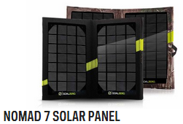
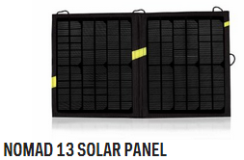
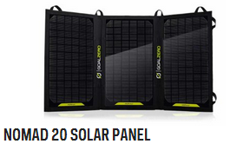
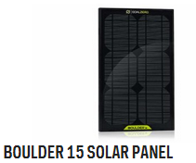
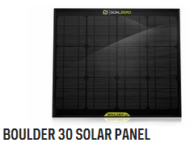
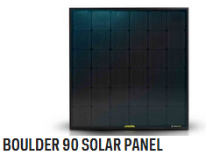
Solar Panels

Slide 6
Solar Panels Specs
Panel | Solar Capacity | Output | Weight
Nomad 7 | 7 watts | USB: 5V (up to 1.0A, regulated) Mini Solar: 6.5V (up to 1.1A un-regulated) Solar: 15V (up to 0.3A, regulated) | 0.8 lbs.
Nomad 13 | 13 watts | USB: 5V (up to 1.0A, regulated) Mini Solar: 6.5V (up to 1.1A un-regulated) Solar: 14-22V (up to 0.9A, un-regulated) | 1.6 lbs.
Nomad 20 | 20 watts | USB: 5V (up to 2.1A, regulated) Mini Solar: 6.5V (up to 1.1A regulated) Solar: 14-22V (up to 1.1A, un-regulated) | 2.5 lbs.
Boulder 15 | 15 watts | Solar: 14-16V (up to 1A, un-regulated) | 3.5 lbs.
Boulder 30 | 30 watts | Solar: 14-16V (up to 2A, un-regulated) | 6.5 lbs.
Boulder 90 | 90 watts | Solar: 14-22V (up to 6A, un-regulated) | 21.6 lbs.
Notes:
Chainable
Monocrystalline Cells
Nomad 7 $80
Nomad 13 $160
Nomad 20 $200
Boulder 15
Boulder 30 $200
Boulder 90 $400

Slide 7
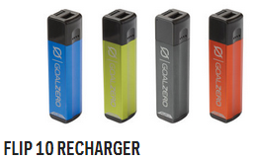
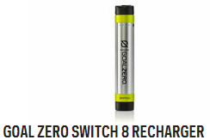
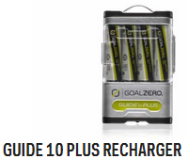
Rechargers / Power Packs
Notes:
Flip 10 $30
Switch 10 $40
Guide 10 $50

Slide 8
Recharger Specs
Recharger | Capacity | Charge | Battery | Output | Weight
Flip 10 | 9.4Wh 3.6V 2600mAh | USB Up to 1A 5W max | Li-NMC | USB: 5V (up to 1.0A, regulated) | 2.5 oz
Switch 8 | 8Wh 3.7V 2200mAh | USB Up to 0.8A 4W max | Li-NMC | USB: 5V (up to 1.0A, regulated) | 3.2 oz
Switch 10 | 11Wh 3.7V 3000mAh | USB Up to 1A 5W max | 18650 By LG chem Samsung | USB: 5V (up to 1.5A, regulated) | 4.0 oz
Guide 10 | 11Wh 4.8V 2300mAh | Solar Up to 1.1A USB Up to 0.8A 4W max | Ni-MH | USB: 5V (up to 1.0A, regulated) | 4.6 oz
Notes:
18650 (aka 168A) 2200-3400mAh, 19 x 67 mm, larger that AA. This cell type is used in many laptop computer batteries
Ni-MH = Nickel–Metal Hydride Battery [Guide 10]
Li-NMC = Lithium Nickel Manganese Cobalt Oxide [Flip 10, Switch 8, Switch 10]

Slide 9
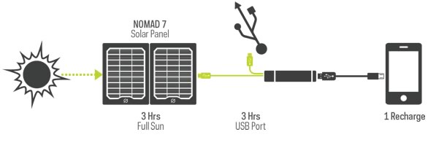
Flip 10
Notes:
$30
Charge Times
USB Power Source: 2.5 hours
Wall: n/a
Car: n/a
Nomad 7 Solar Panel: 2.5 - 5 Hours
Ports
USB Port (output): 5V, up to 1A (5W max), regulated
USB Port (input): 5V, up to 1A (5W max), regulated
Battery Details
Battery Type: Li-ion NMC
Battery Size: 9.4Wh (3.6V, 2600mAh)
Lifecycles: hundreds of cycles
Shelf-life: Keep plugged in, or charge every 3-6 months
Fuses: none
Management system: Charging and low-battery protection built-in
General
Chainable: No
Weight: 2.5 oz (70 g)
Dimensions: 3.6 x 0.75 x 0.75 in (9.2 x 1.9 x 1.9 cm)
Operating usage temp.: 32-104 F (0-40 C)
Certs: CE, FCC, ROHS
Warranty 12 months

Slide 10
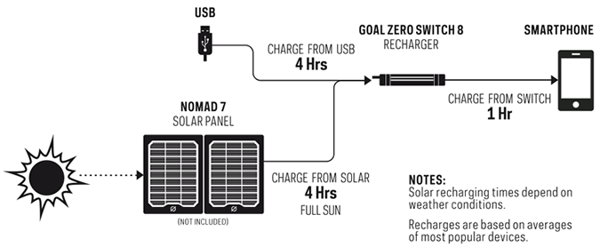
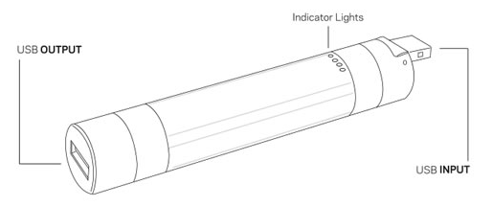
Switch 8
Notes:
$40
Charge Times
USB Power Source: 4 hours
Wall: n/a
Car: n/a
Nomad 7 Solar Panel: 4-8 Hours
Nomad 13 Solar Panel: 4 Hours
Ports
USB Port (output): 5V, up to 1A (5W max), regulated
USB Port (input): 5V, up to 0.8A (4W max), regulated
Mini Solar Port (input): n/a
Battery Details
Battery Type: Li-NMC
Battery Size: 8Wh (3.7V, 2200mAh)
Lifecycles: hundreds of cycles
Shelf-life: Keep plugged in, or charge every 3-6 months
Fuses: none
Management system: Charging and low-battery protection built-in
General
Product SKU: 21004
Chainable: Yes
Weight: 0.2 lbs (91 g)
Dimensions: 1 x 1 x 5 in (2.5 x 2.5 x 12.7 cm)
Operating usage temp.: 32-104 F (0-40 C)
Certs: CE, FCC, ROHS
Warranty 6 months

Slide 11
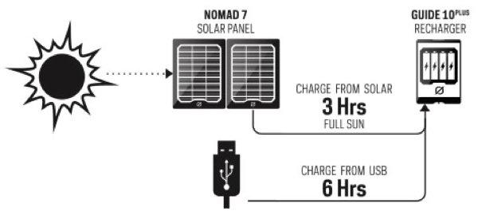
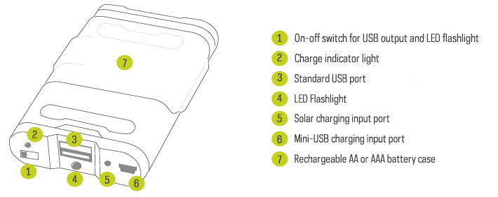
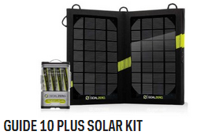
Guide 10
Notes:
$50
$120 Guide 10 & Nomad 7
AA or AAA Batteries
Management system Charging and low-battery protection built-in
Charge Times
USB Power Source: 6-10 hours
Wall: n/a
Car: n/a
Nomad 7 Solar Panel: 3-6 Hours
Nomad 13 Solar Panel: 2.5-5 Hours
Ports
USB Port (output): 5V, up to 1A (5W max), regulated
USB Port (input): 5V, up to 0.8A (4W max), regulated
Mini solar port (input): 6.5V, up to 1.1A
Battery Details
Battery Type: NiMH
Battery Size: 11Wh (4.8V, 2300mAh)
Lifecycles: 500 cycles
Shelf-life: Keep plugged in, or charge every 3-6 months
Fuses: none
General
Product SKU: 21005
Chainable: No
Weight (w/batteries): 6.4 oz (181 g)
Dimensions: 2.5 x 4 x 0.75 in (6.4 x 10.2 x 1.9 cm)
Operating usage temp.: 32-104 F (0-40 C)
Certs: CE, FCC, ROHS
Warranty 6 months
User Guide: Download Here
Light Detail
LED Output: 100mW, white LED

Slide 12
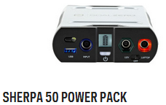
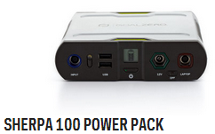
Power Packs
Notes:
Sherpa 50 $230
Sherpa 100 $350

Slide 13
Power Pack Specs
Power Pack | Capacity | Charge | Battery | Output | Weight
Sherpa 50 | 58Wh 11V 5200mAh | Solar 12V AC 14-25V Up to 2A 30W max | Li-NMC | USB: 5V (up to 1.5A, regulated) 6mm: 12V (up to 6A regulated) 9mm: 9-13V (up to 10A un-regulated, side) Laptop: 19V (up to 5A, regulated) AC Inverter: 110VAC (75W max, regulated) | 1.2 lbs.
Sherpa 100 | 98Wh 11V 8800mAh | Solar 12V AC 14-22V Up to 3A 45W max | Li-NMC | USB: 5V (up to 2.1A, regulated) 6mm: 12V (up to 10A regulated) 9mm: 9-13V (up to 10A un-regulated, side) Laptop: 19V (up to 6A, regulated) AC Inverter: 110VAC (100W max, regulated) | 1.9 lbs.
Notes:
Li-NMC = Lithium Nickel Manganese Cobalt Oxide
Both Units have user replacable fuse

Slide 14
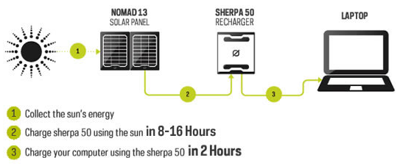
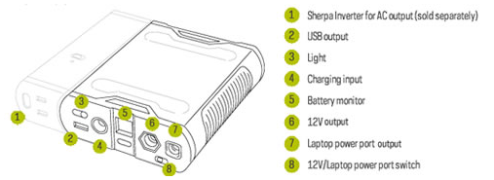
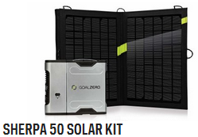
Sherpa 50
Notes:
**** Management system: Charging and low-battery protection built-in ****
$200 Sherpa 50
$410 Sherpa 50, Nomad 13 & Inverter
Charge Times
Wall Charger (30W): 3 hours
Car Charger (30W): 3 hours
Nomad 13 Solar Panel: 8-16 Hours
Nomad 20 Solar Panel: 6-12 Hours
Battery Details
Cell Type: Li-NMC
Peak Capacity: 58Wh (11V, 5200mAh)
Lifecycles: hundreds of cycles
Shelf-life: Keep plugged in, or charge every 3-6 months
Fuses: 15A, user replaceable fuse
Light
LED (output): 100mW, white LED
Ports
USB port (output): 5V, up to 1.5A (7.5W max), regulated
6mm port (output, 6mm, green, hexagon): 12V, up to 8A (100W max), regulated
laptop port (output, 7.4mm, orange, square): 19V, up to 5A (100W max), regulated
sidecar port (chain, 9mm): 9-13V, up to 10A (100W max)
AC inverter US (output, sold separately): 110V, up to 0.7A (75W max), 60Hz, modified sine wave
AC inverter Int. (output, sold separately): 220V, up to 0.35A (75W max), 50Hz, modified sine wave
charging port (input, 8mm, blue circle): 14-25V, up to 2A (30W max)
General
Product SKU: 11004
Chainable: Yes
Weight: 1.2 lbs (544 g)
UV Coated to prevent scratching
Dimensions: 4.5 x 1.5 x 5.25 in (11.4 x 3.8 x 13.3 cm)
Operating usage temp.: 32-104 F (0-40 C)
Certs: CE, FCC, ROHS
Warranty 6 months

Slide 15
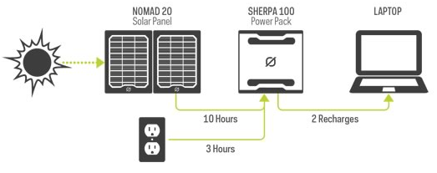
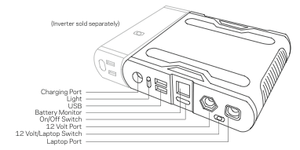
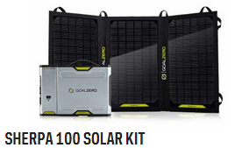
Sherpa 100
Notes:
**** Management system: Charging and low-battery protection built-in ****
$350
$600 Sherpa 100, Nomad 20, AC Inverter
Charge Times
Wall Charger (45W): 3 hours
Car Charger (30W): 4 hours
Nomad 13 Solar Panel: 15-30 Hours
Nomad 20 Solar Panel: 10-20 Hours
Battery Details
Cell Type: Li-NMC
Pack Capacity: 98Wh (11V, 8,800mAh)
Single Cell Equivalent Capacity: 26,400mAh @3.7V
Lifecycles: hundreds of cycles
Shelf-life: Keep plugged in, or charge every 3-6 months
Fuses: 20A, user replaceable fuse
Light
LED (output): 100mW, white LED
Ports
USB port (output): 5V, up to 2.1A (10W max), regulated
6mm port (output, 6mm, green, hexagon): 12V, up to 10A (120W max), regulated
laptop port (output, 7.4mm, orange, square): 19V, up to 6A (120W max), regulated
sidecar port (chain, 9mm): 9-13V, up to 10A (120W max)
AC inverter US (output, sold separately): 110V, up to 0.9 (100W max), 60Hz, modified sine wave
AC inverter Int. (output, sold separately): 220V, up to 0.45A (100W max), 50Hz, modified sine wave
charging port (input, 8mm, blue circle): 14-22V, up to 3A (45W max)
General
Product SKU: 22002
Chainable: Yes
Weight: 1.9 lbs (864 g)
UV Coated to prevent scratches
Dimensions: 5.8 x 1.5 x 5.25 in (14.7 x 3.8 x 13.3 cm)
Operating usage temp.: 32-104 F (0-40 C)
Certs: CE, FCC, ROHS
Warranty 6 months

Slide 16
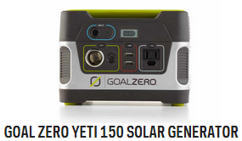
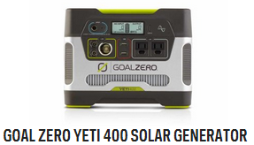
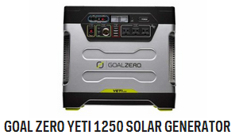
Solar Generators
Notes:
Yeti 150 $230
Yeti 400 $460
Yeti 1250 $1600

Slide 17
Solar Generator Specs
Generator | Capacity | Charge | Battery | Output | Weight
Yeti 150 | 168Wh 12V 14Ah | Solar 12V AC 14-29V Up to 5A 60W max | AGM Lead-Acid | USB: 5V (up to 2.1A, regulated) 6mm: 12V (up to 10A regulated) Car Port: 12V (up to 10A regulated) AC Inverter: 110VAC (80W max, regulated) | 12 lbs.
Yeti 400 | 396Wh 12V 33Ah | Solar 12V AC 14-29V Up to 10A 120W max | AGM Lead-Acid | USB: 5V (up to 2.1A, regulated) 6mm: 12V (up to 10A regulated) Car Port: 12V (up to 10A regulated) AC Inverter 110VAC (80W max, regulated) Power Pole Chaining: 12V (up to 33A) | 29 lbs.
Yeti 1250 | 1200Wh 12V 100Ah | Solar 12V AC 16-48V Up to 10A 160W max | AGM Lead-Acid | USB: 5V (up to 2.1A, regulated) 6mm: 12V (up to 10A regulated) Car Port: 12V (up to 10A regulated) AC Inverter 110VAC (80W max, regulated) Power Pole: 12-14V (up to 30A) Power Pole Chaining: 12V (up to 175A)
Notes:
Yeti 1250 Fuses: 200A (4x 50A fuses in parallel)

Slide 18
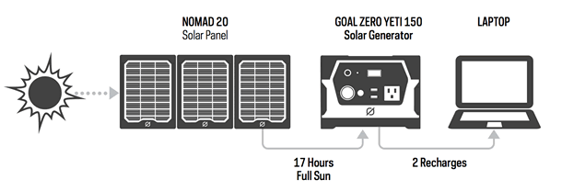
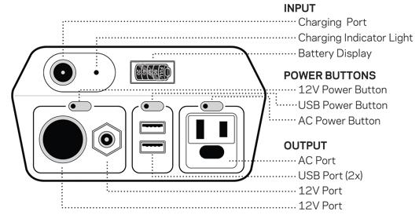
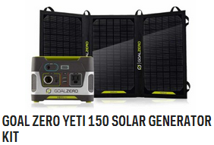
Yeti 150
Notes:
**** Management system: Charging and low-battery protection built-in ****
$230
$430 Goal Zero Yeti 150 & Nomad 20
Charge Times
Wall Charger (45W): 6 hours
Car Charger (30W): 8 hours
Nomad 13 Solar Panel: 26-52 Hours
Nomad 20 Solar Panel: 17-34 Hours
Boulder 15 Solar Panel: 22-44 Hours
Battery Details
Cell Type: AGM Lead-Acid
Peak Capacity: 168Wh (12V, 14Ah)
Lifecycles: hundreds of cycles
Shelf-life: Keep plugged in, or charge every 3-6 months
Fuses: 20A, user replaceable fuse
Ports
USB port (output): 5V, up to 2.1A (10W max), regulated
6mm port (output, 6mm, green, hexagon): 12V, up to 10A (120W max), regulated
12V car port (output): 12V, up to 10A (120W max)
AC inverter US (output, 60Hz, modified sine wave): 110V, 0.7A (80W continuous, 160W surge max)
charging port (input, 8mm, blue, circle):14-29V, up to 5A (60W max)
General
Product SKU: 22004
Chainable: No
Weight: 12 lbs (5.4 kg)
Dimensions: 7.75 x 5.75 x 6.75 in (19.7 x 14.6 x 17.2 cm)
Operating usage temp.: 32-104 F (0-40 C)
Certs: CE, FCC, ROHS
Warranty 6 months

Slide 19
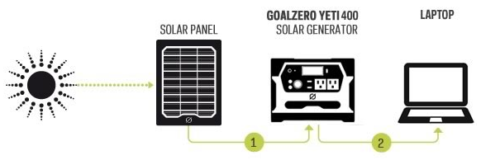
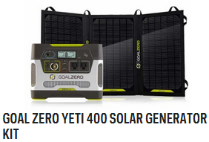
Yeti 400
Notes:
**** Management system: Charging and low-battery protection built-in ****
$460
$660 Yeti 400 & Nomad 20
Charge Times
Wall Charger (72W): 5 hours
Car Charger (30W): 13 hours
Boulder 30 Solar Panel: 26-52 Hours
Battery Details
Cell Type: AGM Lead-Acid
Peak Capacity: 396Wh (12V, 33Ah)
Lifecycles: hundreds of cycles
Shelf-life: Keep plugged in, or charge every 3-6 months
Fuses: none
Ports
USB port (output): 5V, up to 2.1A (10W max), regulated
6mm port (output, 6mm, green, hexagon): 12V, up to 10A (120W max)
12V car port (output): 12V, up to 10A (120W max)
AC inverter US (output, 60Hz, pure sine wave): 110V, 2.6A (300W continuous, 600W surge max)
Power Pole Chaining port: 12V, up to 33A (400W max)
charging port (input, 8mm, blue, circle):14-29V, up to 10A (120W max)
General
Product SKU: 23000
Chainable: Yes
Weight: 29 lbs (13.2 kg)
Dimensions: 10.25 x 8 x 8 in (26 x 20.3 x 20.3 cm)
Operating usage temp.: 32-104 F (0-40 C)
Certs: CE, FCC, ROHS
Warranty 6 months

Slide 20
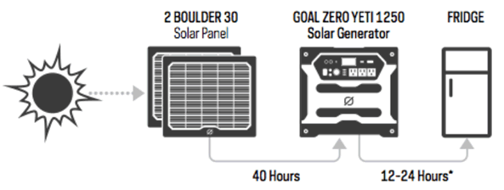
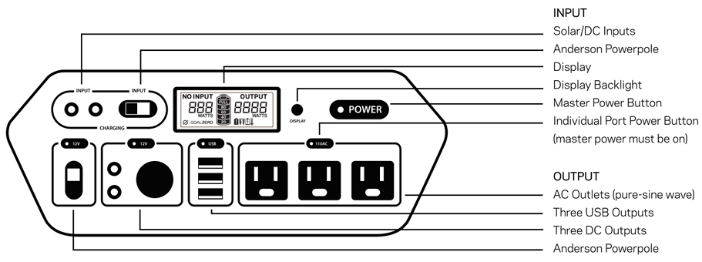
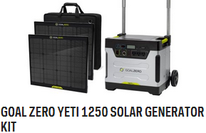
Yeti 1250
Notes:
***** Management system: MPPT charge controller, low battery protection ******
$1400
$1800 Yeti 1250, 2 x Boulder 30, Roll Cart, Solar Panel Travel Case
Charge Times
Wall Charger (72W): 18 hours
Car Charger (30W): 44 Hours
2 x Boulder 30: 40-80 Hours
3 x Boulder 30: 27-54 Hours
Battery Details
Cell Type: AGM Lead Acid
Peak Capacity: 1200Wh (12V, 100Ah)
Lifecycles: hundreds of cycles
Shelf-life: Keep plugged in, or charge every 3 months
Fuses: 200A (4x 50A fuses in parallel)
Ports
USB port (output): 5V, up to 2.1A (10.5 W max), regulated
6mm port (output, 6mm): 12V, up to 10A (120W max)
12V car port (output): 12V, up to 10A (120W max)
12V Power Pole Port (output): 12-14V, up to 30A (360W max)
AC inverter (output, pure sine wave): 110V 10A (1200W continuous, 1500W surge max)
Charging port (input, 8mm): 16-48V, up to 10A (160W max)
Power Pole charging port (input): 16-48V, up to 20A (240W max)
Power Pole chaining port: 12V, up to 175A (2100W max)
General
Product SKU: 31901
Chainable: Yes
Weight: 103 lbs (46.7 kg)
Dimensions: 11 x 16 x 14.5 in (27.9 x 40.6 x 36.8 cm)
Operating usage temp.: 32-104 F (0-40 C)
Certs: CE, FCC, ROHS
Warranty 6 months

Slide 21
Charge Times
Charge Time in Hours | Nomad 7 | Nomad 13 | Nomad 20 | Boulder 15 | Boulder 30 | Boulder 90
Switch 8 | 4-8 | 4 | 4 | Not Compatible | Not Compatible | Not Compatible
Switch 10 | 4-8 | 4 | 4 | Not Compatible | Not Compatible | Not Compatible
Guide 10 | 3-6 | 2.5-5 | 2.5-5 | Not Compatible | Not Compatible | Not Compatible
Sherpa 50 | Not Recommended | 8-16 | 6-12 | 8-16 | 4-8 | 1-3
Sherpa 100 | Not Recommended | 15-30 | 10-20 | 13-26 | 7-14 | 3-6
Yeti 150 | Not Recommended | 26-52 | 17-34 | 22-44 | 11-22 | 3-6
Yeti 400 | Not Recommended | Not Recommended | 40-80 | 53-106 | 26-52 | 9-18
Yeti 1250 | Not Recommended | Not Recommended | Not Recommended | Not Recommended | 80-160 | 27-54

Slide 22
Charge Your Device
Charge Times | Headlamp 4Wh | Smartphone 5-6Wh | GoPro 5Wh | Digital Camera 8Wh | Tablet 25-42Wh | Laptop 50Wh
Switch 8 | 2 | 1 | 1-2 | 1 | 25% Boost | N/A
Switch 10 | 2 | 1 | 1-2 | 1 | 25% Boost | N/A
Guide 10 | 2 | 1 | 1-2 | 1 | 1-2 | 1
Sherpa 50 | 12 | 7 | 9 | 5 | 1-2 | 1
Sherpa 100 | 25 | 14 | 18 | 10 | 2-4 | 1-2
Yeti 150 | 37 | 15 | 25 | 12 | 6 | 1-2
Yeti 400 | 100 | 30+ | 70+ | 20+ | 10+ | 3-5
Yeti 1250 | 300+ | 100+ | 200+ | 100+ | 45+ | 20+

Slide 23
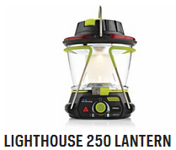
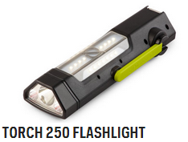
Lights
Notes:
Lighthouse 250 $80
Torch 250 $80

Slide 24
Light Specs
Light | Capacity | Charge | Battery | Output | Weight
Lighthouse 250 | 16.3Wh 3.7V 4400mAh | USB Up to 1A 5W max | Li-NMC | Light: 250 Lumens USB: 5V (up to 1.5A, regulated) | 1.1 lbs.
Torch 250 | 16.3Wh 3.7V 4400mAh | Solar 0.8W USB Up to 1A 5W max | Li-NMC | Light: 250 Lumens USB: 5V (up to 1.5A, regulated) | 14.4 oz

Slide 25
Lighthouse 250
Notes:
$80
Run Times
One side lit: 48 hours (low), 12 hours (high), 5 hours (turbo)
Both sides lit: 24 hours (low), 6 hours (high), 2.5 hours (turbo)
Hand Crank: 2.2W (cranking at 120 RPM), 1 minute of crank = 10 minutes of light
Light
LED (output): 2x3W, warm white CREE LED, 250 Lumens
Battery:
Cell Type: Li-NMC
Cell Capacity: 16.3 Wh (3.7V, 4400mAh)
Lifecycles: hundreds of cycles
Shelf Life: Keep plugged in, or charge every 3-6 months
Management System: Charging and low-battery protection built-in
Ports
USB port (output): 5V, up to 1.5A (7.5W max), regulated
USB port (input): 5V, up to 1A (5W max
General
Product SKU: 32001
Chainable: No
Weight: 1.1 lbs (498 g)
Dimensions: 4.5 x 5 x 6.6 in (11.5 x 12.7 x 16.5 cm)
Certs: CE, FCC, ROHS
Warranty 12 months

Slide 26
Torch 250
Notes:
$80
Charge Times
Goal Zero Nomad 7: 7-14 hours
Built in Solar: 23-46 hours
USB Source: 7 Hours
Run Times
Spot Light: 15 hours (low), 7 hours (high)
Flood Light: 48 hours (low), 22 hours (high)
Hand Crank: 2.2W (cranking at 120 RPM), 1 minute of crank = 2 minutes of light
Light
LED (output): 250 Lumens, 4000K warm white cree LED's
Spot Light: 180 Lumens
Flood Light: 70 Lumens
Solar
Rated Power: 0.8W
Cell Type: Monocrystalline
Battery
Cell Type: Li-NMC
Cell Capacity: 16.3 Wh (3.7V, 4400mAh)
Lifecycles: hundreds of cycles
Shelf Life: Keep plugged in, or charge every 3-6 months
Management System: Charging and low-battery protection built-in
Ports
USB port (output): 5V, up to 1.5A (7.5W max), regulated
USB port (input): 5V, up to 1A (5W max)
General
Chainable: No
Weight: 14.4 oz (408 g)
Dimensions: 10 x 3.5 x 1.75 in (25.4 x 8.9 x 4.5 cm)
Operating Useage Temp: 32-104 F (0-40 C)
Warranty 6 months

Slide 27
Ham Decision
Buy a Manufactured Kit
Sherpa 50 = $410
Sherpa 100 = $600
Yeti 150 = $430
Yeti 400 = $660
Yeti 1250 = $1800
Build Your Own

Slide 28
What Your Build Should Include
Solar Panel
Charge Controller
Batteries
Low Battery Protection
Output Regulator
Connectors
Wire
Housing
Plan that all the components work together

Slide 29
Build Plan
Budget
Equipment System will power
Capacity of System
Storage
Max Output
Size of System (Physical & Weight)

